Slide 1

Each hackathon project will be built around a specific theme - a focus area that outlines the kind of problems you’ll be solving and the impact your solution aims to create. Themes are designed to help guide your creativity, give structure to your ideas, and ensure your project is aligned with the overall goals of the event.
Your final project will be evaluated by a panel of judges who are experts in that theme’s domain. A strong alignment between your project and your chosen theme can significantly boost your score, as it shows you’ve understood the problem space, used relevant insights, and tailored your solution to the needs and opportunities in that area.
In short:
Themes help you focus your ideas.
Judges are specialists in the theme you choose.
The closer your solution matches the theme’s goals, the better your chances of impressing the panel.

Slide 2
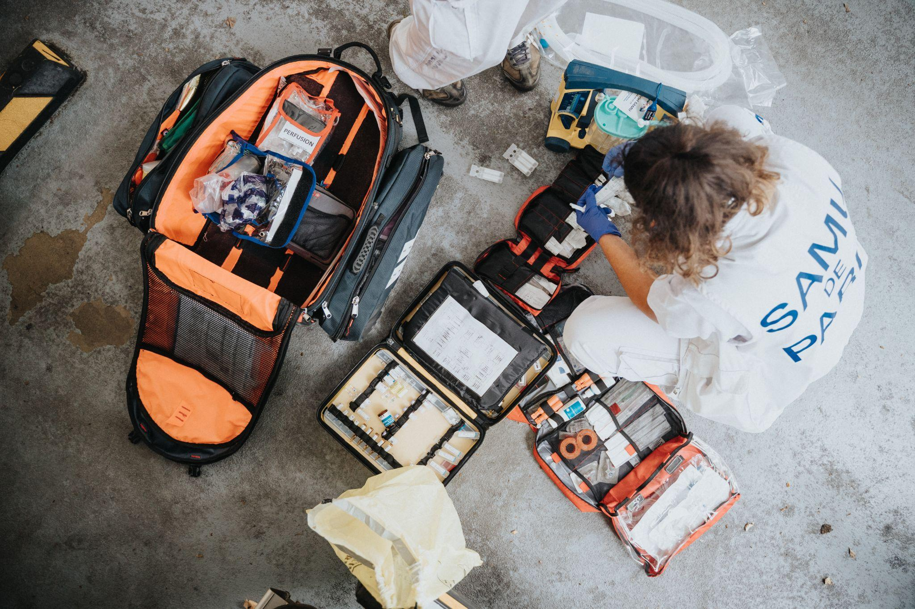
Health and Humanity
Help people access essential life services in underserved communities and better identify global health threats with diagnostic and preventive methods.

Slide 3

Table of Contents
… 04
…05
…06
…07
…14
1
Executive Summary
Overview
Relevant SDGs
Subthemes
Examples
2
3
4
Notes:
5

Slide 4

Executive Summary
Increase the access and capacity of essential life services in underserved communities and better identify global health threats by improving diagnostic measures and the quality of preventative actions. A socially sustainable system can ensure an adequate and equal distribution of social services such as health care, gender equality, & political responsibility.
Key UN SDGs: SDG 2: Zero Hunger, SDG 3: Good Health & Well-Being, SDG 6: Clean Water & Sanitation, SDG 16: Peace, Justice, Strong Institutions
Subthemes:
Global Food Systems
Sanitation
Valuing Water
Access to Healthcare
Inequality and Uneven Development
Humanitarianism & Conflict

Slide 5
Overview
Global Health and Humanity covers how to better identify global health threats by improving diagnostic measures and the quality of preventative action. This goes beyond pandemics and includes subjects from maternal health, to tropical diseases, political unrest, vaccination and mental health, education and training of medical staff, and inequality and access barriers.
How can we offer health care solutions for everyone? How can we urgently respond to the important challenges already occurring?

Slide 6
UN SDGs
#2: Zero Hunger
#6: Clean Water & Sanitation
Achieve food security for all people everywhere in the world.
Universal and equitable access to safe and affordable drinking water and clean sanitation
#3: Good Health & Well Being
#16: Peace, Justice, and Strong Institutions
The pandemic has halted or reversed progress in healthcare and shortened life expectancy. The goal is to ensure healthy lives and promote well-being for all at all ages.
Significantly reduce all forms of violence and address conflict, insecurity, weak institutions and limited access to justice that remain a great threat to sustainable development.
‹#›

Slide 7
Subthemes

Slide 8
Global Food Systems
Health & Humanity: Global Food Systems
“Food is life. But in countries, communities and households in every corner of the world, this essential need – this human right – is going unfulfilled. Every day, hundreds of millions of people go to bed hungry. Children are starving. Three billion people cannot afford a healthy diet. And nearly one-third of all food that is produced is lost or wasted. - António Guterres, United Nations Secretary General
Global Food Systems: The term “food systems” refers to all the elements and activities related to producing and consuming food, and their effects, including economic, health, and environmental outcomes. (OECD)
Did you know?
“33% of fish stocks are overfished; 60% are maximally sustainably fished; 90% of fish used for feed could be eaten by humans.” (IPCC)
See Modern Technological Innovations
Most recent changes in organizations of global food systems
Sustainable Food Systems

Slide 9
Access to Healthcare
Health & Humanity: Access to Health Care
“Adequate healthcare access not only requires the availability of comprehensive healthcare facilities but also affordability and knowledge of the availability of these services. As an extended responsibility, healthcare providers can create mechanisms to facilitate subjective decision-making in accessing the right kind of healthcare services as well various options to support financial needs.” - Amit Agarwal, AIIMS
Access to Healthcare: At least four aspects require evaluation for access: If services are available and there is an adequate supply of services, then the opportunity to obtain health care exists, and a population may 'have access' to services. (Pubmed.gov)
Did you know?
“At least half of the world’s population cannot obtain essential health services.And each year, large numbers of households are being pushed into poverty because they must pay for health care out of their own pockets.” (WHO)
See Modern Technological Innovations
Universal Health Coverage
Health in Africa Initiative

Slide 10
Sanitation
Health & Humanity: Sanitation
“The links between lack of water and sanitation access and the development goals are clear, and the solutions to the problem are known and cost-effective. A 2012 WHO study shows that every US $1 invested in improved sanitation translates into an average global economic return of US $5.5.” – UN Water Report
Renewable Energy: Sanitation generally refers to the provision of facilities and services for the safe disposal of human urine and feces. (World Bank DataBank)
Did you know?
“3.6 billion people, nearly half the world’s population, do not have access to safely managed sanitation in their home. Of those, 1.9 billion people live with basic sanitation services, and 494 million people practice open defecation.” (CDC)
See Modern Technological Innovations
Lack of adequate sanitation
New technologies in sanitation

Slide 11
Inequality and Uneven Development
Health & Humanity: Inequality and uneven development
“People at the lower end of the spectrum have particularly been left behind. We haven’t done a good job growing our economy. That would’ve fixed a lot of that problem.” - Jamie Dimon, CEO of JP Morgan Chase
Inequality and Uneven Development: Inequality is a complex concept and is difficult to measure. Excessive inequality can erode social cohesion, lead to political polarization. Inequality can be viewed from different perspectives, all of which are related. Most common metric is Income Inequality, which refers to the extent to which income is evenly distributed within a population. (IMF)
Did you know?
“Oxfam has calculated that to amass even a fifth of the average fortune of the world’s five richest billionaires, you would need to have saved $10,000 a day since the building of the pyramids in Egypt.” (Oxfam)
See Modern Technological Innovations
How to pay for universal basic income
Economic growth that is distributed

Slide 12
Valuing Water
Health & Humanity: Valuing Water
“Recognizing, measuring and expressing water’s worth, and incorporating it into decision-making, are fundamental to achieving sustainable and equitable water resources management.” - United Nations Report
Valuing Water: Valuing water means recognizing and considering all the diverse benefits and risks provided by water, and encompassing its economic, social, and ecological dimensions as well as its diverse cultural and. religious meanings. (Sustainable Development Knowledge Platform)
Did you know?
“The average family can waste 180 gallons per week, or 9,400 gallons of water annually, from household leaks. That's equivalent to the amount of water needed to wash more than 300 loads of laundry. Household leaks can waste approximately nearly 900 billion gallons of water annually nationwide.” (US EPA)
See Modern Technological Innovations
Right price can encourage efficiency in water
Innovative Water Conservation in India

Slide 13
Humanitarianism and Conflict
Health & Humanity: Humanitarianism and Conflict
“Underlining all humanitarian action are the principles of humanity, impartiality, neutrality and independence. These principles, derived from international humanitarian law, have been taken up by the United Nations in General Assembly Resolutions 46/182 and 58/114.” - UNHCR
Humanitarianism and Conflict: Humanitarianism is at once a broad dedication to and belief in the fundamental value of human life. Though lacking an agreed definition, this central ethics of humanitarianism crosses cultures and history. (PHAP)
Did you know?
“The OCHA of the UN Secretariat is responsible for coordinating responses to emergencies through the Inter-Agency Standing Committee, that include the UN system entities most responsible for providing emergency relief.” (UN)
See Modern Technological Innovations
Facts and Figure on humanitarian action
Humanitarianism in Ukraine

Slide 14
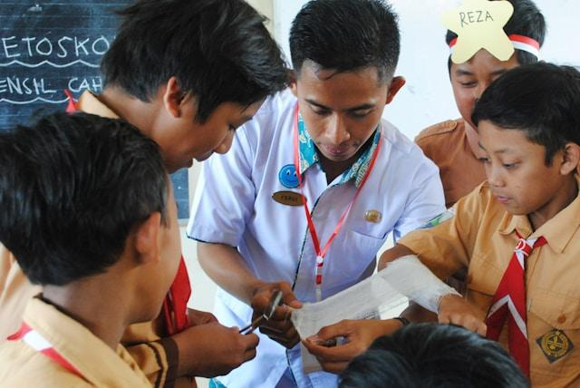

Examples from Previous Hack the Globe Winners
https://globalspark.world/hacktheglobe
Medi (2025 – 1st Place)
DermaSpect (2021 – People’s Choice)
An AI-powered portable medical records platform for refugees, enabling secure health data access and translation.
An AI image-recognition tool assisting healthcare professionals in diagnosing skin conditions.

